Slide 1
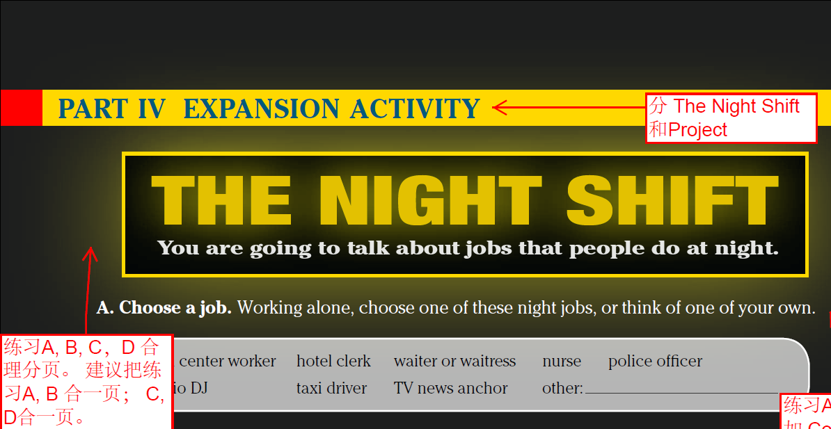

The night shift Project
Content Note
A call center worker is paid to answer phone calls, usually for customer service. It is common for big companies to outsource customer service call lines to other countries, so even though customers dial a domestic number, they may get an operator in another part of the world. Because of time differences, this means that call center workers have to be ready to take calls all night long.
A hotel clerk refers to someone who stays up during the night to be at the front desk in a hotel. This person handles late-night check-ins, phone calls, or helps guests if other problems arise.
Additional night-shift jobs include: convenience store worker, airplane pilot and flight attendant, gas station attendant, truck driver. Note that many stores are now open 24 hours every day, which means that many retail workers now need to work a night shift.
A. Choose a job. Working alone, choose one of these night jobs, or think of one of your own.
call center worker hotel clerk waiter or waitress nurse police officer
radio DJ taxi driver TV news anchor other:_____________
B. Research the job. Imagine you do this job. What is a typical day like for you? Make a schedule. Write your daily activities and the times you do them. Think about these questions:
When do you usually wake up?
When do you start work? When do you finish?
What do you do after work?
When do you go to sleep?
What is good about your night job? What’s hard?

Slide 2
The night shift Project
C. Interview a partner. Talk about your routine. Your partner will take notes and ask you questions. Take turns with different partners.
Do you like your job?
Sometimes. It’s hard. I’m always sleepy. But the money is good.
D. Compare different jobs. With a partner, list the jobs you learned about in B and C. Then explain:
What are the good things about these night jobs? What are the bad things?
Which night job is the best? Which is the worst?

Slide 3
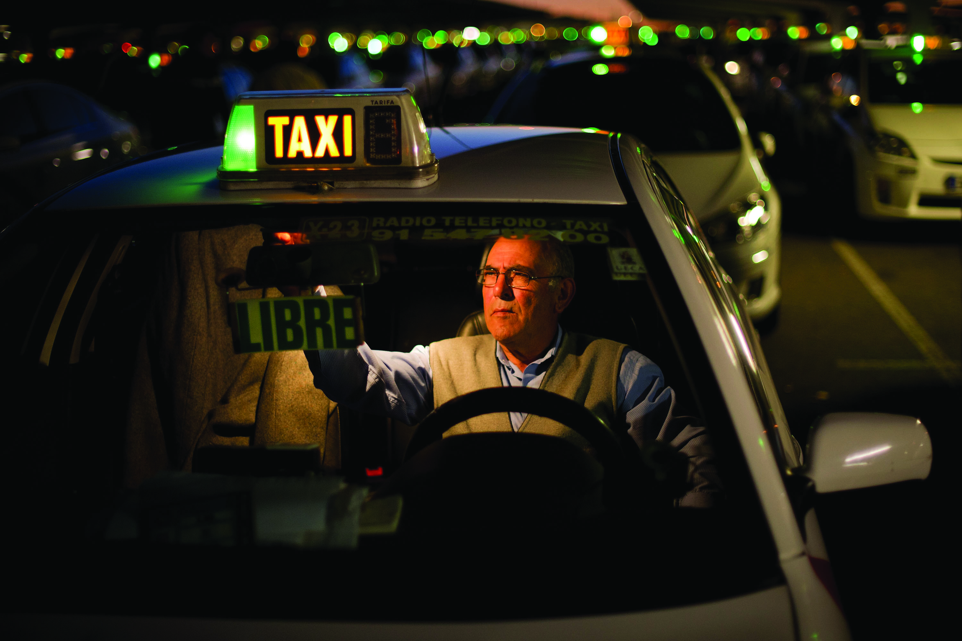
The night shift Project
Interview a night shift worker. Find people who work (or used to work) the night shift. Interview them to find out what a typical day is like for them. Make a presentation about the people. Include photos. Show your presentation to the class and ask them which night job they think is best and which job they think is worst.
This taxi driver in Madrid, Spain,
works at night.

